Slide 1

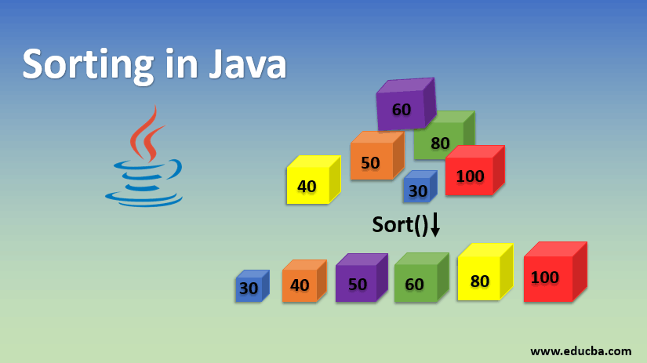
Data Structures & Algorithms
IT-516-01
Professor Sean Harrignton
Vinita Malhar Chinchwade , Daishik Kaushik Ghatalia , Ernest Goodman, Sowjanya Kunti ,Vamsi Kiran Reddy Muddam Shankar, Tasmiya Salim Mujawar

Slide 2
Agenda
What is Sorting
Quick Sort
Heap Sort
Shell Sort
Advantages and disadvantages

Slide 3
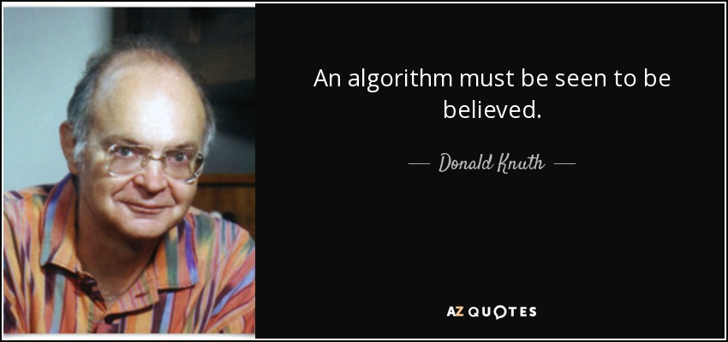
This guy is a father of analysis of algorithms.

Slide 4
What is Sorting?

Slide 5


Sorting, generally, stands for an arranging the elements of an array or list so that they are placed in some relevant order which may be either ascending or descending.
Again, sorting is any process of arranging items systematically, and has two common, yet distinct meanings: ordering: arranging items in a sequence ordered by some criterion; categorizing: grouping items with similar properties

Slide 6

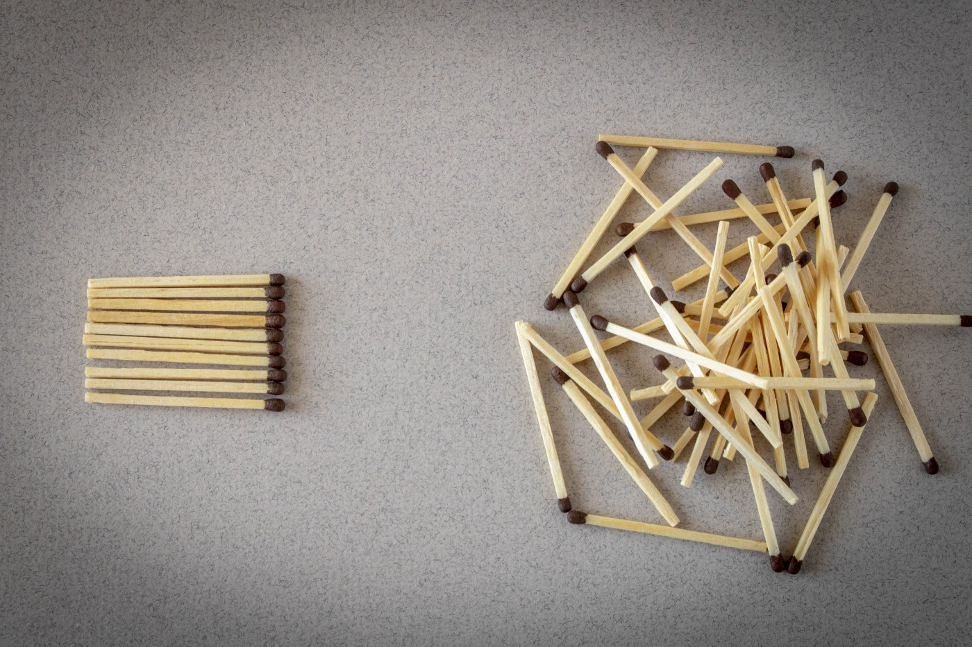
A sorting algorithm is defined as an algorithm that puts the elements of a list in a certain order, which can be either numerical order, lexicographical order, or any user-defined order
– Bubble, Insertion, Tree
– Selection, Merge, Radix
– Quick, Heap, Shell

Slide 7
Quicksort

Slide 8
Quicksort-How it works?
Quicksort is one of the sorting algorithms. Developed by British computer scientist Tony Hoare in 1959 and published in 1961, it is still a commonly used algorithm for sorting. When implemented well, it can be somewhat faster than merge sort and about two or three times faster than heapsort.
There are many different versions of quickSort that pick pivot in different ways.
Always pick first element as pivot.
Always pick last element as pivot (implemented below)
Pick a random element as pivot.
Pick median as pivot.
The quick sort algorithm works as follows:
1. Program selects an element pivot from the array elements.
2. It rearranges the elements in the array in such a way that all elements that are less than the pivot appear before the pivot and all elements greater than the pivot element come after it
3. It recursively sorts the two sub-arrays thus obtained

Slide 9
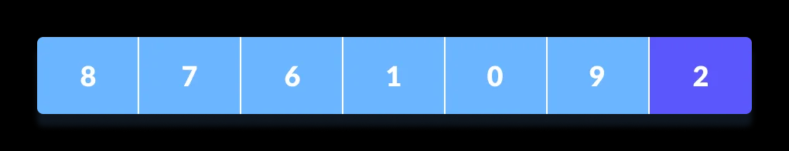
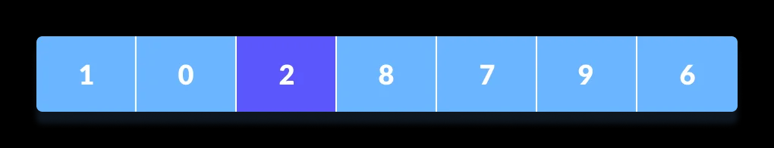
Mechanics of Quicksort Algorithm
1. Selecting the Pivot Element
Depending of different variations of quicksort algorithm the pivot element could be selected from different positions. Here, we will be selecting the rightmost element of the array as the pivot element.
2. Rearranging the Array
Now the elements of the array are rearranged so that elements that are smaller than the pivot are put on the left and the elements greater than the pivot are put on the right.

Slide 10
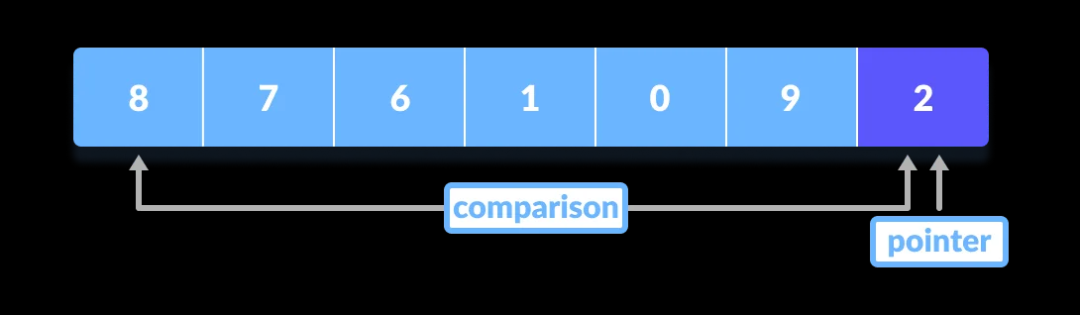
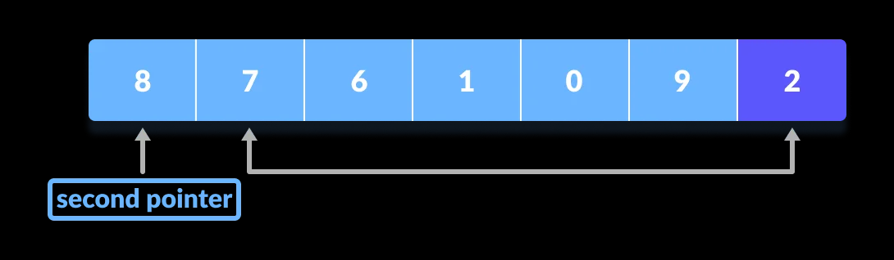
Here's how we rearrange the array:
1. A pointer is fixed at the pivot element. The pivot element is compared with the elements beginning
from the first index.
2. If the element is greater than the pivot element, a second pointer is set for that element. Now we
have two pointers.

Slide 11
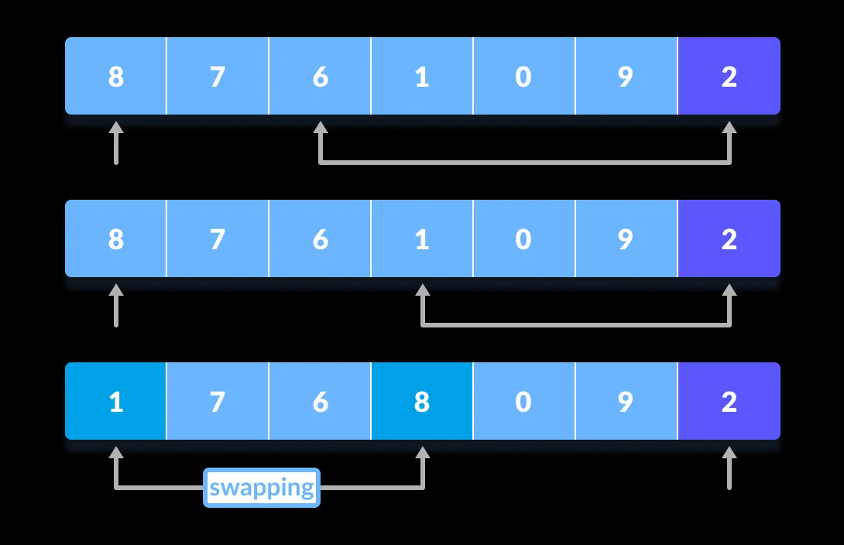
3. Now, pivot is compared with other elements. If an element smaller than the pivot element is reached, the smaller element is swapped with the greater element found earlier.
4. Again, the process is repeated to set the next greater element as the second pointer. And, swap it with another smaller element.

Slide 12
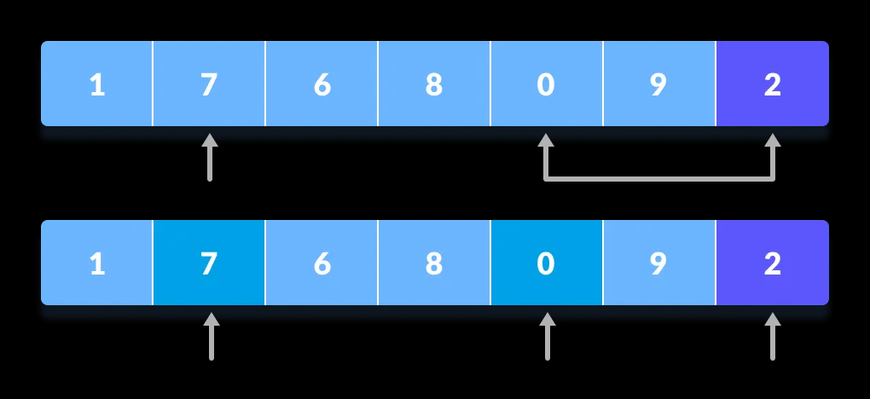
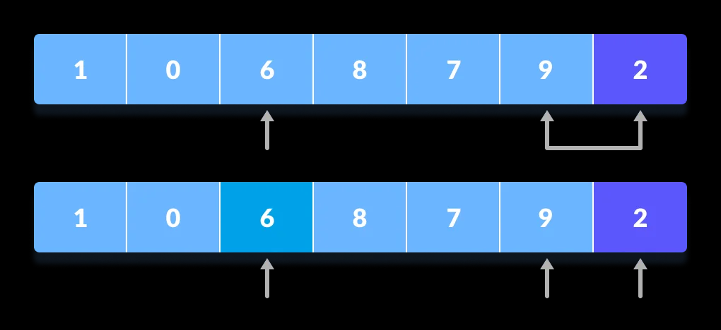
5.The process goes on until the second last element is reached.

Slide 13
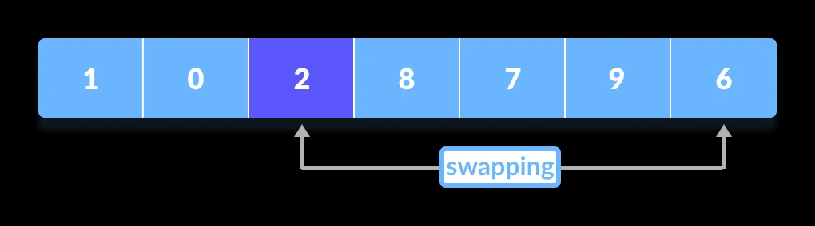
6. Finally, the pivot element is swapped with the second pointer.

Slide 14
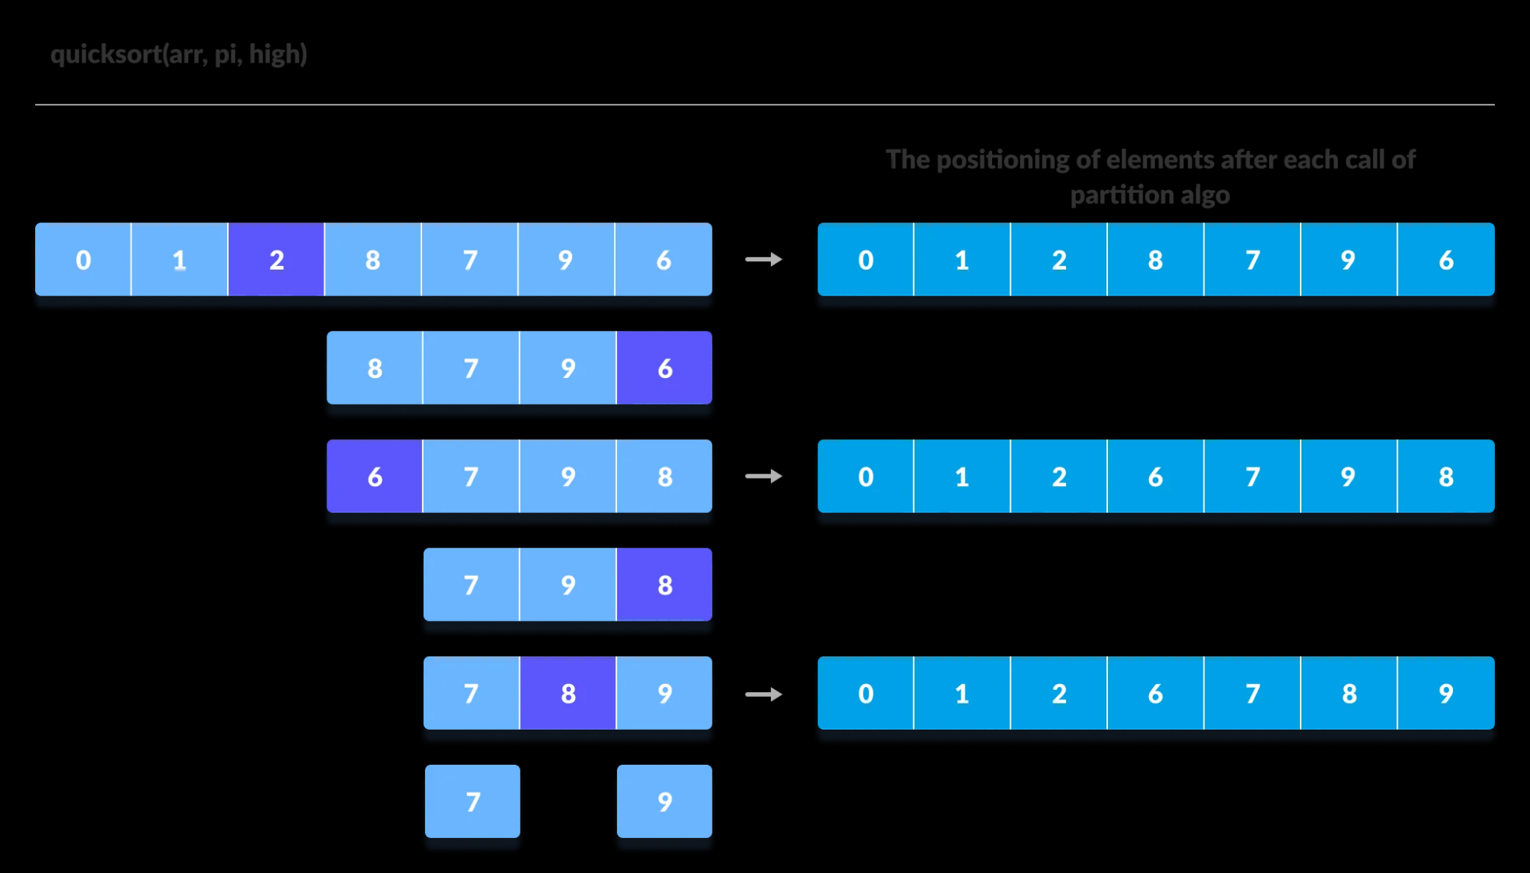
3. Dividing Subarrays
As indicated above, quicksort is a divide-and-conquer method for sorting. Here, a pivot elements are again chosen for the left and the right sub-parts separately. And, step 2 is repeated.

Slide 15
Implementation of quicksort algorithm (JAVA)

Slide 16
static void quickSort(int[] arr, int low, int high)
{
if (low < high)
{
// pi is partitioning index, arr[p]
// is now at right place
int pi = partition(arr, low, high);
// Separately sort elements before
// partition and after partition

Slide 17
quickSort(arr, low, pi - 1);
quickSort(arr, pi + 1, high);
}
}
/* This function takes last element as pivot, places
the pivot element at its correct position in sorted
array, and places all smaller (smaller than pivot)

Slide 18
to left of pivot and all greater elements to right
of pivot */
static int partition(int[] arr, int low, int high)
{
// pivot
int pivot = arr[high];
// Index of smaller element and
// indicates the right position
// of pivot found so far

Slide 19
int i = (low - 1);
for(int j = low; j <= high - 1; j++)
{
// If current element is smaller
// than the pivot
if (arr[j] < pivot)
{
// Increment index of

Slide 20
Heap Sort

Slide 21
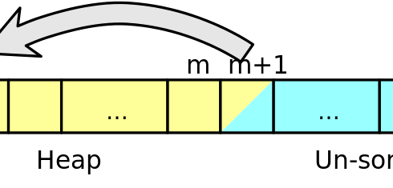
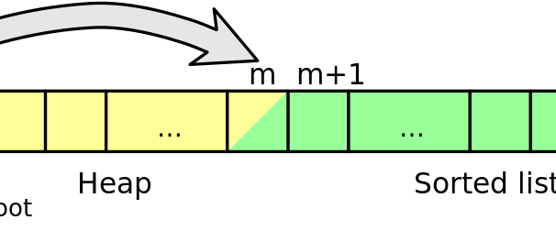
Heap Sort Algorithm
A heap is a data structure that stores a collection of objects (with keys), and has the following properties:
Complete Binary tree
Heap Order
It is implemented as an array where each node in the tree corresponds to an element of the array
The binary heap data structures is an array that can be viewed as a complete binary tree. Each node of the binary tree corresponds to an element of the array. The array is completely filled on all levels except possibly lowest
This Photo by Unknown Author is licensed under CC BY-SA
This Photo by Unknown Author is licensed under CC BY-SA

Slide 22
Heap
The root of the tree A[1] and given index i of a node, the indices of its parent, left child and right child can be computed
PARENT (i) return floor(i/2) LEFT (i) return 2i RIGHT (i) return 2i + 1

Slide 23
Types of Heap
The heapsort algorithm consists of two phases: - build a heap from an arbitrary array - use the heap to sort the data
To sort the elements in the decreasing order, use a min heap. Store data in ascending order Has property of
A[Parent(i)] ≥ A[i]
To sort the elements in the increasing order, use a max heap. Store data in descending order Has property of
A[Parent(i)] ≤ A[i]

Slide 24
Example :
81 | 90 | 9 | 11 | 15 | 78 | 56 | 22
Step 1: Create binary heap
81
90
9
11
15
78
56
22
Heap

Slide 25
Step 2: Call heapify () and construct max heap
81
90
90
9
81
78
Heapify
11
15
78
56
22
15
9
56
22
11
Max Heap
Heap
Sorted Iteration 1:
90 | 81 | 78 | 22 | 15 | 9 | 56 | 11

Slide 26
Step 3: delete the root element (90) from the max heap. In order to delete this node, it get swap it with the last node, i.e. (11). After removing the root element, again heapify it to convert it into max heap.
11
81
81
81
78
22
78
78
Heapify
22
15
9
56
11
15
9
56
Max Heap
Heap after deleting 90
Sorted Iteration 2:
81 | 22 | 78 | 11 | 15 | 9 | 56 | 90

Slide 27
78
78
78
56
78
78
78
78
78
78
78
78
Heapify
78
Sorted Iteration 3:
15
15
15
56
56
56
56
56
56
56
22
56
56
56
56
22
22
22
22
78 | 22 | 56 | 11 | 15 | 9 | 81 | 89
11
15
22
9
22
9
22
9
22
9
9
9
11
11
15
11
11
9
11
15
15
9
9
11
9
11
9
11
Heap after deleting 81
Max Heap
9
56
Heapify
22
56
15
22
Sorted Iteration 4:
56 | 15 | 22 | 9 | 11 | 78 | 81 | 89
11
15
9
11
Heap after deleting 78
Max Heap

Slide 28
11
22
Heapify
15
22
15
11
Sorted Iteration 5:
22 | 15 | 11 | 9 | 56 | 78 | 81 | 89
9
9
Heap after deleting 56
Max Heap
9
15
Sorted Iteration 6:
Heapify
15 | 9 | 11 | 22 | 56 | 78 | 81 | 89
15
11
9
11
Heap after deleting 22
Max Heap

Slide 29
Step 4: After repeating the above steps, at last swap first and last node and delete the last node from heap, and thus the resulted array seems to be the sorted.
11
11
Heapify
Sorted Iteration 7:
11 | 9 | 15 | 22 | 56 | 78 | 81 | 89
9
9
Heap after deleting 15
Max Heap
Heapify
Sorted Iteration 8:
9
9
9 | 11 | 15 | 22 | 56 | 78 | 81 | 89
Heap after deleting 11
Max Heap
Sorted Array:
Remove 9
9
Empty
9 | 11 | 15 | 22 | 56 | 78 | 81 | 89

Slide 30

Implementation of HeapSort Algorithm

Slide 31
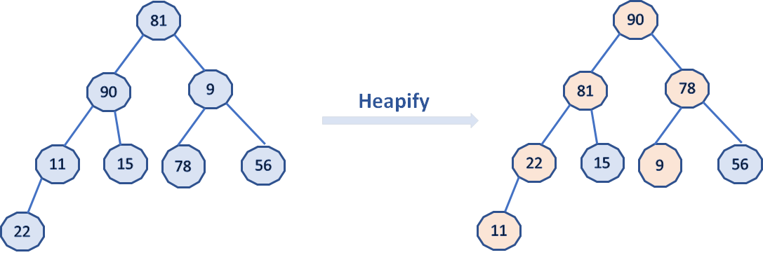
void heapify(int arr[], int n, int i)
{
// Initialize largest as root
int largest = i;
int l = 2 * i + 1; // left = 2*i + 1
int r = 2 * i + 2; // right = 2*i + 2
// If left child is larger than root
if (l < n && arr[l] > arr[largest])
largest = l;
// If right child is larger than largest so far
if (r < n && arr[r] > arr[largest])
largest = r;
// If largest is not root
if (largest != i) {
int swap = arr[i];
arr[i] = arr[largest];
arr[largest] = swap;
// Recursively heapify the affected sub-tree
heapify(arr, n, largest);
}
arr[largest]=81
arr[l]=90
arr[r]=9

Slide 32
90 | 81 | 78 | 22 | 15 | 9 | 56 | 11
// One by one extract an element from heap
for (int i = n - 1; i > 0; i--) {
// Move current root to end
int temp = arr[0];
arr[0] = arr[i];
arr[i] = temp;
// call max heapify on the reduced heap
heapify(arr, i, 0);
}
11 | 81 | 78 | 22 | 15 | 9 | 56 | 90

Slide 33
Shell Sort

Slide 34

Highly efficient sorting algorithm.
Based on the insertion sort algorithm.
Allows the exchange of items that are far apart.
Shell sort is also known as diminishing increment sort.

Slide 35

Only efficient for medium size lists.
Fastest of all sorting algorithms
5 times faster than the bubble sort and little over twice as fast as the insertion sort

Slide 36

Complex algorithm
Not efficient as the merge, heap, quick sort.

Slide 37
Example:- Let the element of arrays are:-
Step 1:- Set the value for the interval, which for this example is 4.
33 | 31 | 40 | 8 | 12 | 17 | 25 | 42
Step 2:- Separate the list into sub-list with the same interval which is 4
33 | 31 | 40 | 8 | 12 | 17 | 25 | 42
33
12
17
31
25
40
42
8

Slide 38
Step 3:- Use Insertion sort and sort the sub-lists. Continue until interval is 1.
12 | 17 | 25 | 8 | 33 | 31 | 40 | 42
12
25
33
40
17
8
31
42
12 | 8 | 25 | 17 | 33 | 31 | 40 | 42

Slide 39
Step 4:- When the interval is 1, use the insertion sort on the list.
12 | 8 | 25 | 17 | 33 | 31 | 40 | 42
8 | 12 | 25 | 17 | 33 | 31 | 40 | 42
8 | 12 | 25 | 17 | 33 | 31 | 40 | 42
8 | 12 | 25 | 17 | 33 | 31 | 40 | 42
8 | 12 | 17 | 25 | 33 | 31 | 40 | 42
8 | 12 | 17 | 25 | 33 | 31 | 40 | 42
8 | 12 | 17 | 25 | 33 | 31 | 40 | 42

Slide 40
8 | 12 | 17 | 25 | 31 | 33 | 40 | 42
8 | 12 | 17 | 25 | 31 | 33 | 40 | 42
8 | 12 | 17 | 25 | 31 | 33 | 40 | 42

Slide 41
Implementation
of Shell Sort Algorithm

Slide 42
int sort(int arr[])
{ int n = arr.length;
for (int gap = n/2; gap > 0; gap /= 2)
{
for (int i = gap; i < n; i += 1)
{
int temp = arr[i];
int j;
for (j = i; j >= gap && arr[j - gap] > temp; j -= gap)
arr[j] = arr[j - gap];
arr[j] = temp;
}
}
return 0;
}

Slide 43
Algorithm Comparison
Heap Sort
Quick Sort
Shell Sort
Heapsort is based on the heap data structure
Fast: Heapsort always runs in O(nlogn) time - Space efficient: Heapsort takes (1) additional space
Slow in practice. While the asymptotic complexity of heap sort makes it look faster than quicksort, in real systems heap sort is often slower
HeapSort can be useful where memory form better on small datasets usage is limited, such as in embedded systems
Quicksort operates by recursively partitioning the array
Fast. On average, Quicksort runs in O(nlogn) time
Slow Worst-Case. Although it isn't common, Quicksort can take O(n) in the worst case - Lame implementation may result in stack overflow error, since it may require O(n) nested recursive calls
Quicksort perform better on small database
Shell sort is a comparison-based sorting. The time complexity of Shell Sort depends on the gap sequence
Its best-case time complexity is O(n* logn) and the worst case is O(n* log2n).
Shell sort can also be used as a sub-algorithm of the introspective sort to sort short subarrays and avoid slowdowns when the recursion depth exceeds a certain threshold.

Slide 44


